Slide 1
Sprint Review 1
Team Sloths

Slide 2
Agenda
“Done” Product Backlog for Sprint 1
Spikes Completed
Metrics
Goals for Sprint 2

Slide 3
1. What is in our “Done” Product Backlog for Sprint 1?
All Spikes from the Product Backlog have been completed
Previous team’s software has been thoroughly searched through and cleaned up
All Sprint 1 Backlog items have been completed
Fairness Algorithm
Database Modifications
Prime-time slots logic

Slide 4
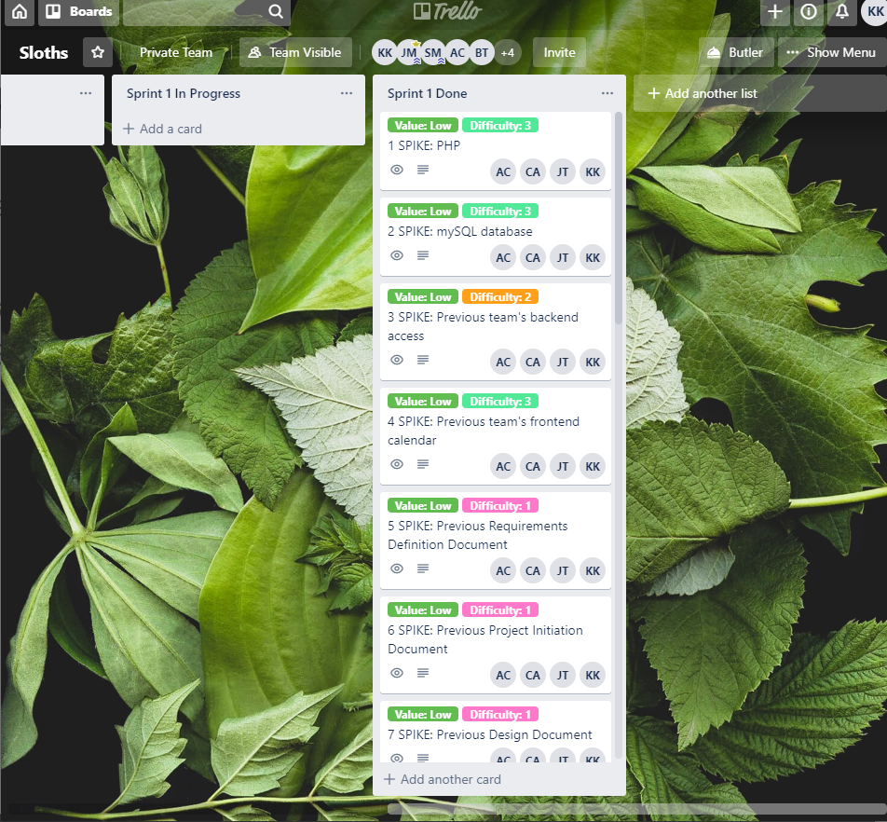
See for yourself:
https://trello.com/b/JElzXGGZ/sloths

Slide 5
Fairness Algorithm
The algorithm that decides which user gets a time slot if more than one user requested that specific time slot.
Ex. If two users request Friday 3pm-6pm, who gets the slot?
Cuts down on time, money, energy wasted deciding who gets what, and when
ALL AUTOMATIC- No direct human interaction involved!
Are you ok with this definition? Any add-ons to this definition we can incorporate into the next Sprint?
Notes:
This was our definition for the algorithm in Sprint 1, and will be the definition of it going forward

Slide 6
Fairness Algorithm
A score is kept for each user
Score increments for “bad” behavior and decrements for “good” behavior, respectively
Easier than flagging users
May only be Boolean flags
May need multiple flags per user, which will quickly become complex and hard to track
Questions, Comments, Concerns?
Notes:
Ex. separate flag for missed workdays, missed time slots, etc.

Slide 7
Fairness Algorithm
Score keeping allows us to add or remove a user’s points based on every little option
Different actions can have different scoring weights
Ex. Cancelling a prime-time slot vs. cancelling a non-prime-time slot
Questions, Comments, Concerns?

Slide 8
Fairness Algorithm
How to increment points (bad)
Receiving a prime-time slot from the algorithm
How to decrement points (good)
Receiving a non-prime-time slot from the algorithm
Not getting picked for a slot at all
Comments, Questions, Concerns?
Notes:
To name a few

Slide 9
Questions (to Sponsors) About Fairness Algorithm
Would you like the admin to have the option to change the point increment and decrements? Or can we hard code them into the software and make them final?
What do we do with the leftover requests that did not get approved?
Will they be wiped from the system? Roll over into the next week? Be forced to share with another slot?
If we do decide to store leftover requests, how long do we have to keep them for?
What metrics do you want us to record when the manager wants to request reports?
How far do the metrics have to go back? 1 Month? 1 Year? Other?
Are there any other variables you would like us to consider (or not consider) in our Fairness Algorithm that was not already mentioned?
Notes:
If so, we would need to add that as an option to the admin page
Ex. if we have 40 request for one week and 35 slots, what happens to those 5 extra slots?
-
-
-
-

Slide 10
Database Modifications

Slide 11
Prime-time slots logic

Slide 12
Questions about Prime-time Logic
Monica (Product Owner) has informed us what the prime-time slots are. Would you like us to hard code them into the software (permanent prime time slots), or give the admin the ability to change them if necessary?

Slide 13
2. Spikes Completed for Sprint 1
The development team has grown more familiar with:
PHP
mySQL
JavaScript
Previous team’s backend and frontend; how they were achieved
Previous team’s PID and Requirements definition document (so we know how much they accomplished)
Do you recommend any SPIKEs for us to learn for Sprint 2?
Notes:
In other words, anything that the previous Development team struggled with later in the project that we can get a head start on?

Slide 14
3. Metrics

Slide 15
4. Goals for Sprint 2 (not yet definite)
Continue modifying Fairness Algorithm based on your feedback
Metrics for managers
Fixing up the time slot reservations logic
More abilities for admins to work with
Clean up the UI
Anything else you want us to work on for Sprint 2?

Slide 16
Thank you, Brian and Nacer!
-Team Sloths

